Slide 1

Agile, Docker and Jenkins

Slide 2

Agenda
Agile
Theory!
Docker
Infrastructure
Docker
Docker Demo and Hands-on
Jenkins – HandsOn
CI/CD
Jenkins
Jenkins pipeline
Jenkins file
Jenkins Scripts

Slide 3
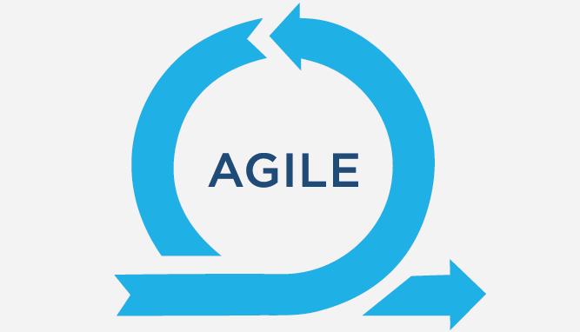

Slide 4
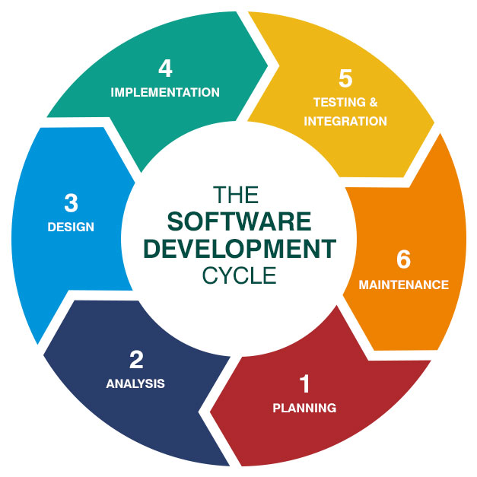
Requirement gathering, elicitation and planning
Requirement Analysis
Design
Implementation
Testing and Integration
Delivery and Maintenance

Slide 5

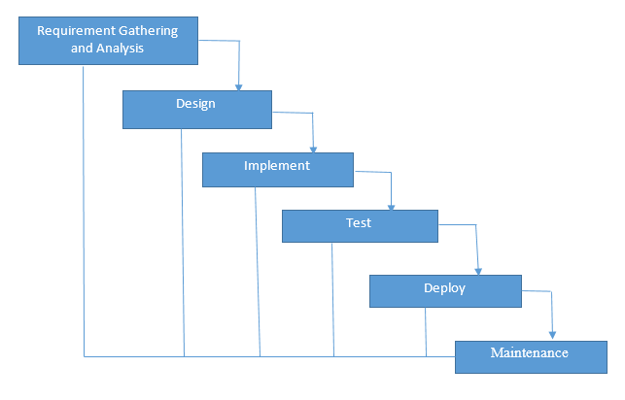
Waterfall Model

Slide 6
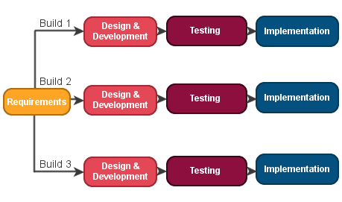
Iterative
Model

Slide 7
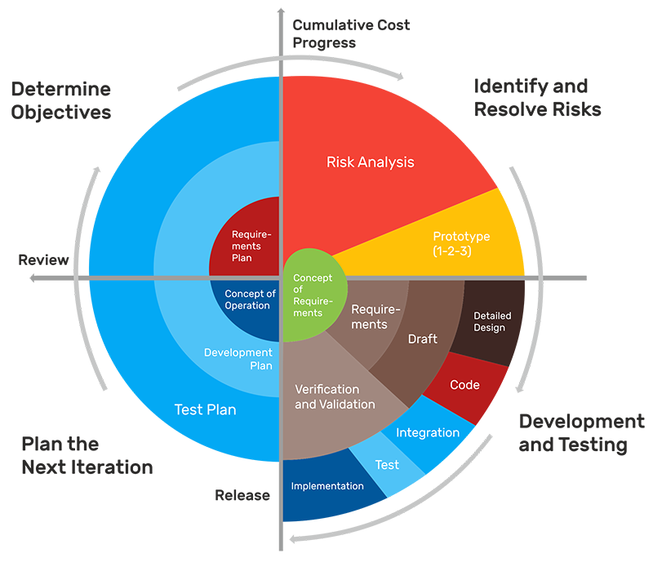
Spiral
Model

Slide 8
Agile
Fails fast, Fail early, fail often, fail cheap!

Slide 9
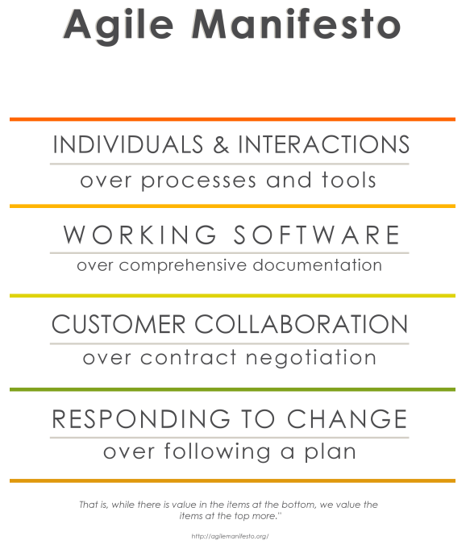
Agile Manifesto

Slide 10

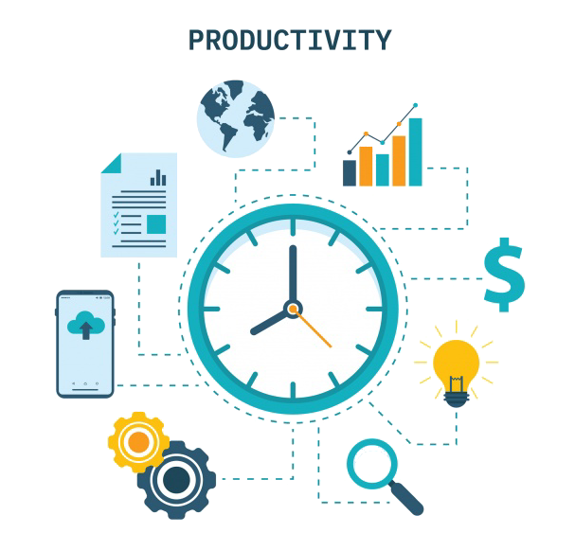
Agile Principles
Our highest priority is to satisfy the customer through early and continuous delivery of valuable software.
Welcome changing requirements, even late in development. Agile processes harness change for the customer’s competitive advantage.
Deliver working software frequently, from a couple of weeks to a couple of months, with a preference to the shorter timescale.
Business people and developers must work together daily throughout the project.
Build projects around motivated individuals. Give them the environment and support they need, and trust them to get the job done.
The most efficient and effective method of conveying information to and within a development team is face-to-face conversation.
Working software is the primary measure of progress.
Agile processes promote sustainable development.
The sponsors, developers, and users should be able to maintain a constant pace indefinitely.
Continuous attention to technical excellence and good design enhances agility.
Simplicity–the art of maximizing the amount of work not done–is essential.
The best architectures, requirements, and designs emerge from self-organizing teams. At regular intervals, the team reflects on how to become more effective, then tunes and adjusts its behavior accordingly.

Slide 11
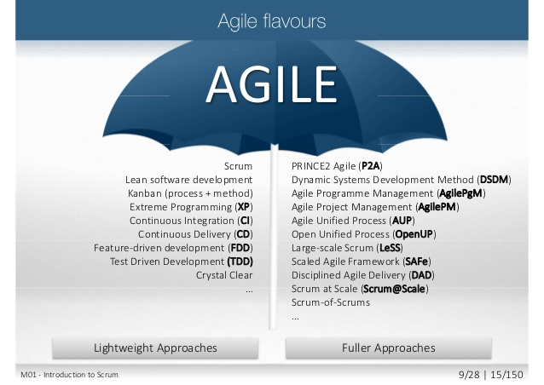
Agile Methods and Framework

Slide 12
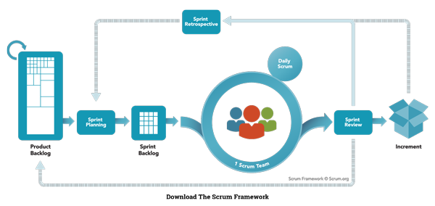
Scrum
Scrum is a framework, for effective team collaboration and can address complex problems while productively and creatively delivering products of highest possible value.

Slide 13
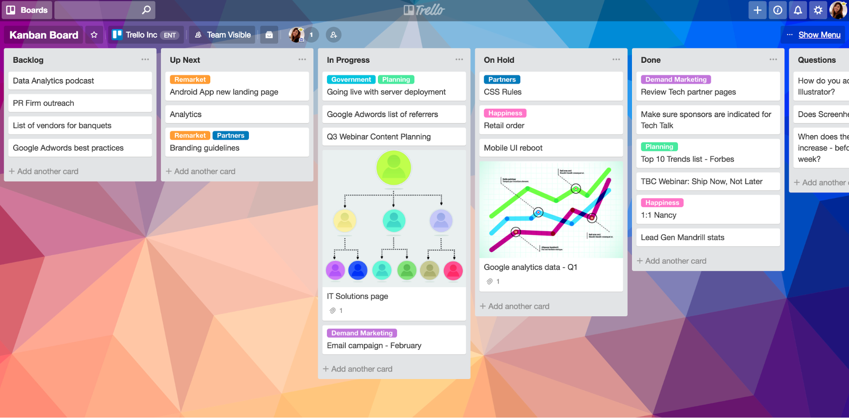
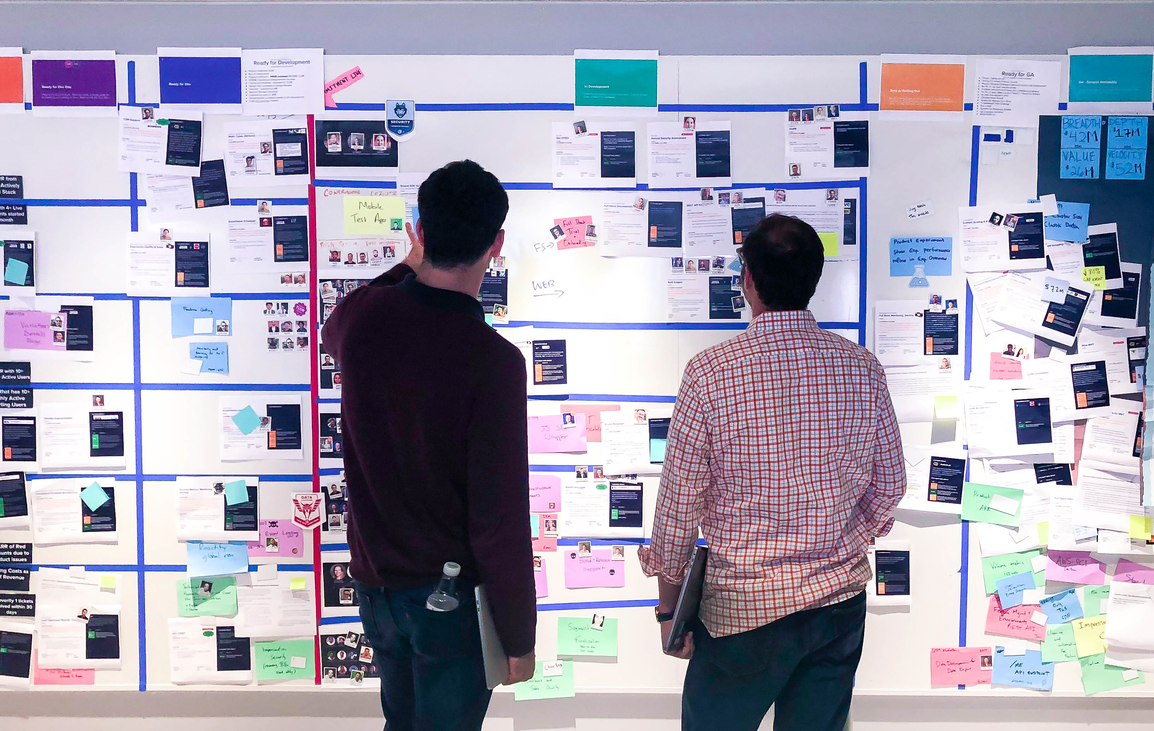
Kanban
The work items in Kanban are visually represented on a Kanban board, allowing team members to see the state of every piece of work. Kanban can be either a physical board or a digital board
Famous tools from Kanban board are Jira and Trello.

Slide 14


Slide 15
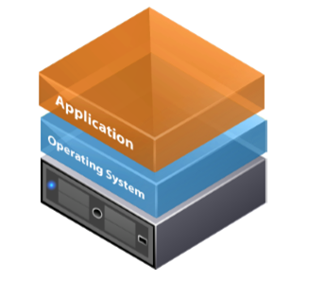
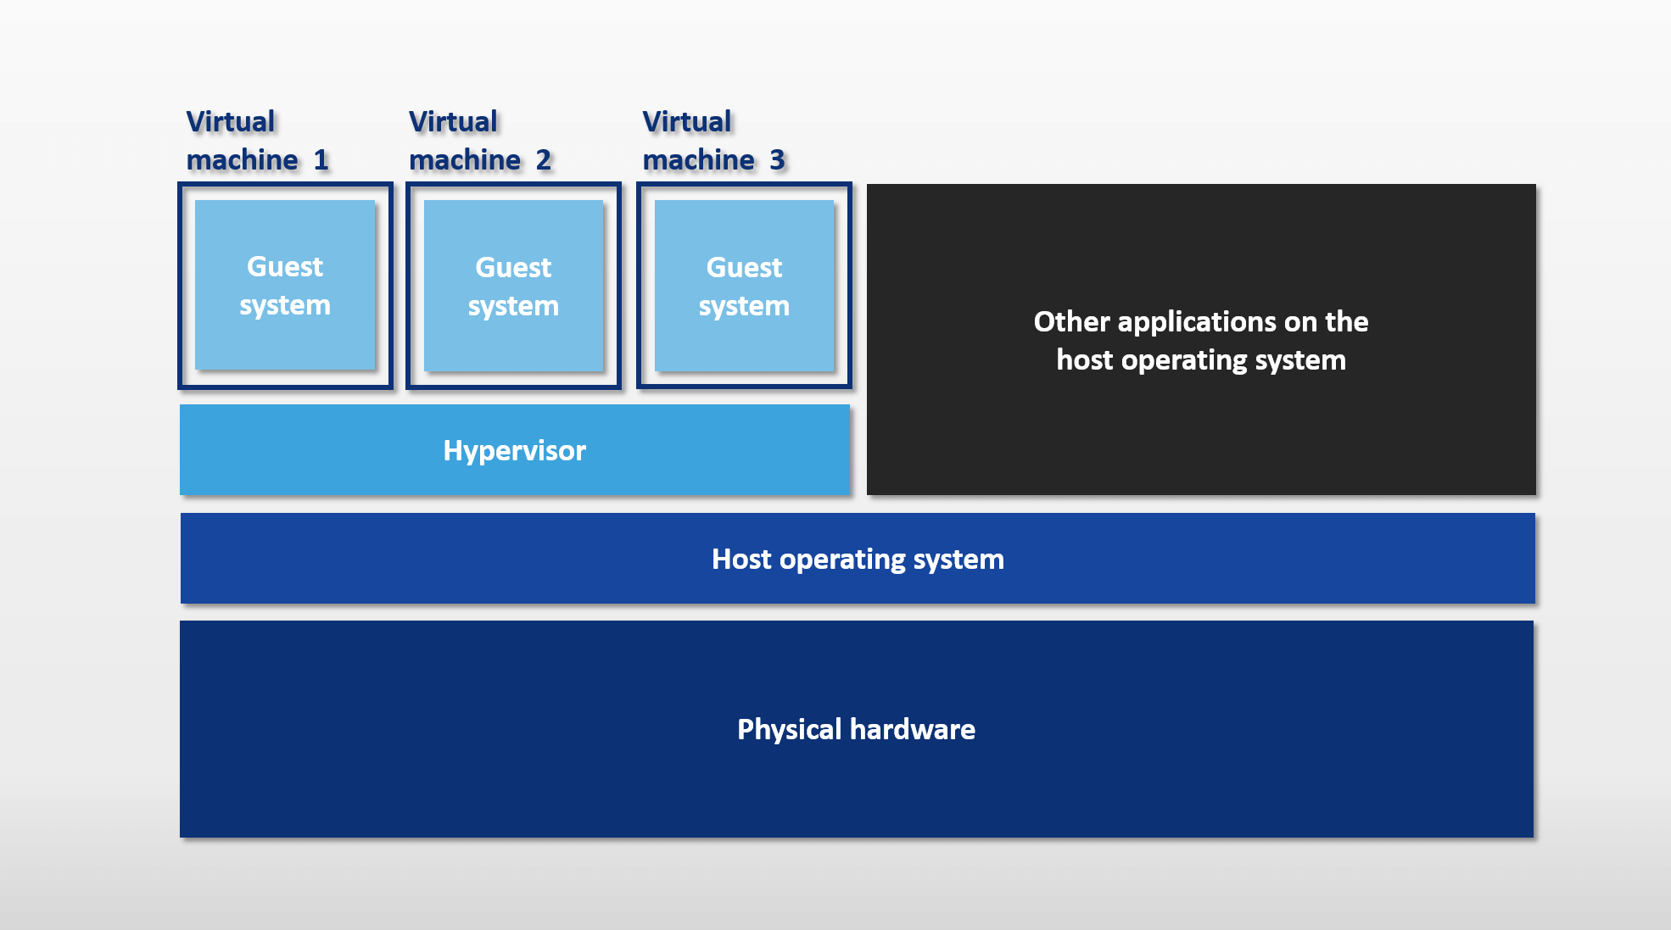
Understanding Infrastructure

Slide 16
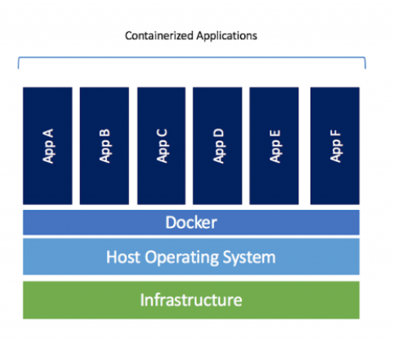
Docker
Notes:
There needs to be a framework in place that will provide guidance for theory development, model building, empirical studies and research.
1. Individual characteristics: knowledge
2. Psychological variables: individual attitude and behaviour
3. Sociological behaviour: when individuals interact with group
4. Technological variables: tools and techniques
5. System variables: Policies, management style and communication system

Slide 17
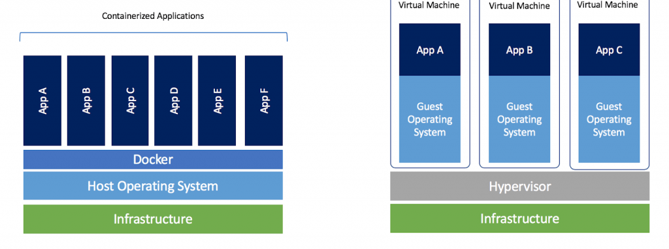
How is Docker different from VM’s
Notes:
In conceptual model, productivity is considered to be the function of Task Capacity, Individual capacity, Individual effort and uncontrollable interference.
Interferences cannot be controlled by individuals or organisations, (Resource shortages, machine breaks could be controlled by proper maintenance but power failures due to storms or natural calamities cannot be controlled)

Slide 18

Docker interal working
Notes:
In conceptual model, productivity is considered to be the function of Task Capacity, Individual capacity, Individual effort and uncontrollable interference.
Interferences cannot be controlled by individuals or organisations, (Resource shortages, machine breaks could be controlled by proper maintenance but power failures due to storms or natural calamities cannot be controlled)

Slide 19

Docker ARchitecture
Notes:
In conceptual model, productivity is considered to be the function of Task Capacity, Individual capacity, Individual effort and uncontrollable interference.
Interferences cannot be controlled by individuals or organisations, (Resource shortages, machine breaks could be controlled by proper maintenance but power failures due to storms or natural calamities cannot be controlled)

Slide 20

Notes:
Effects of improvements - trends about how the individuals are addressing new challenges, , how much is team investing in repetitive vs new tasks
Expertise analysis:individuals that are good at doing something and are doing the task much effectively than the threshold time. Will be useful in aligning them to new challenges, training others, process improvements

Slide 21
Q & A

Slide 22
Thank You!

